Slide 1
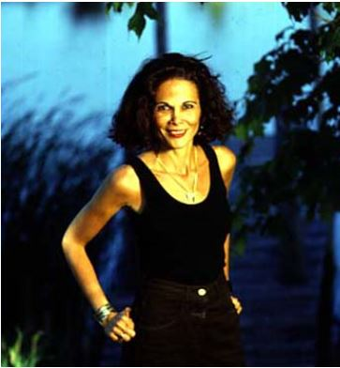
Fighting for Freedom – In the Time of the Butterflies
Next
1
2
3
4
5
6
The book In the Time of the Butterflies by Julia Alvarez is a fictionalized account of the Mirabal Sisters, three women who were part of an uprising against Rafael Trujillo, the brutal dictator of the Dominican Republic. Their dedication to freedom has served as an inspiration to many.
Julia Alvarez Image Source: Gale Literature Reference Center, by subscription. Flag of the República Dominicana Image Source: CultureGrams, by subscription.
In the face of adversity, how do some individuals prevail while others fail?

Slide 2
Information Sources
Next
1
2
3
4
5
6
Use the resources below to research your topic.
Culture of the Dominican Republic | Cult of Personality | Latin American Events 1930s-1960s | Trujillo | US Events 1930s-1960s | Modern-day Rebellions
Overview of Dominican Society Amnesty International Report Gender Roles Roles of Women | Overview Deconstructing the Cult Cult of Personality Song Famous Examples | Castro & Cuba Bay of Pigs Changes in the 20th Century River Massacre DR Genocide | Overview Overview Assassination Opposition News Footage of the Assassination (YouTube video) Overview & Photograph Luperion Invasion | 1965 News Footage US/Dominican Republic Relations Cuban Missile Crisis Bay of Pigs Cold War Overview of Cold War 1950s Timeline Organization of American States | Arab Spring Limits of Arab Spring Syria Egypt Turkey Yemen

Slide 3
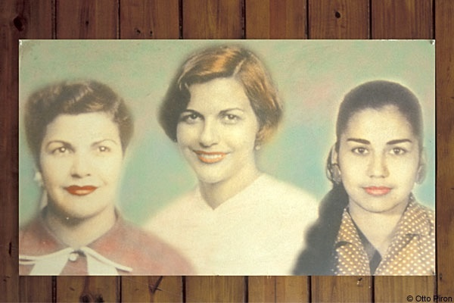
Assignment: Gathering Information
Next
1
2
3
4
5
6
Step 1: Your teacher will divide the class to examine one of the topics on slide 2.
Step 2: Take notes on your topic.
Step 3: Design a poster to teach your classmates about your topic. Your class will refer to these posters as you study the novel. On the bottom of your poster answer the following question: Apply your research to address how your topic contributed to the fight for freedom in the Dominican Republic and overcoming adversity.
Image Source: Wikimedia Commons

Slide 4
Dig Deeper: Extension
Next
1
2
3
4
5
6
Create a digital presentation for your group’s topic.
Create a Prezi.
Prezi is a cloud-based software that offers an innovative approach to presentations. Your teacher may need to assist you in creating an account. Prezi tutorial
Create an Animoto video.
Your teacher may need to assist you in creating an account.
Create a video using Photostory.
You do not need to make an account to access this program.

Slide 5
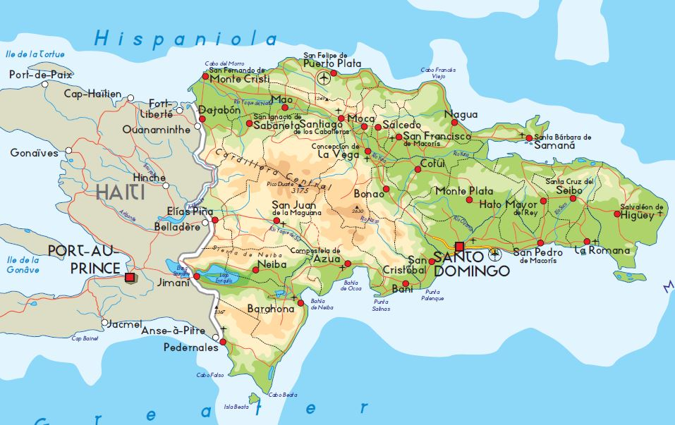
Assessments
Next
1
2
3
4
5
6
Each group presentation will be displayed in a gallery walk. One member of your group will be the “expert” and stay at the group’s table to “discuss” their topic with people who ask questions. The “expert” who stays at the table should be knowledgeable enough to explain/elaborate on the research topic. All “non-experts” travel and gather information on the other presentations completing the “Introducing the Butterflies” gallery walk resource sheet.
Image source: CultureGrams, by subscription.

Slide 6
Teacher Support Materials
1
2
3
4
5
6
MSC Standards for English Language Arts:
RL2 CCR Anchor Standard Determine central ideas or themes of a text and analyze their development; summarize the key supporting details and ideas
RL3 CCR Anchor Standard Analyze how and why individuals, events, and ideas develop and interact over the course of a text.
RL6 CCR Anchor Standard Assess how point of view or purpose shapes the content and style of a text.
AASL Standards for the 21st Century Learner:
1.1.6 Read, view, and listen for information presented in any format (e.g., textual, visual, media, digital) in order to make inferences and gather meaning.
2.1.6 Use the writing process, media and visual literacy, and technology skills to create products that express new understandings
3.1.1 Conclude an inquiry- based research process by sharing new understandings and reflecting on the learning.
3.1.3 Use writing and speaking skills to communicate new understandings effectively
3.1.4 Use technology and other information tools to organize and display knowledge and understanding in ways that others can view, use, and assess
ISTE Technology Standards for Students:
Students demonstrate creative thinking, construct knowledge, and develop innovative products and processes using technology.
Students use digital media and environments to communicate and work collaboratively, including at a distance, to support individual learning and contribute to the learning of others
Students demonstrate a sound understanding of technology concepts, systems, and operations.
Time Management:
The lesson should is designed to take one 90-minute class session.
Differentiation Strategies:
Group/partner students heterogeneously by reading ability and technology skills
Have students use assistive tools embedded in the BCPS databases such as read aloud and dictionary links.
Learning Preferences/Styles:
Field dependent, auditory, visual, active, reflective, global, sequential, kinesthetic
Notes to the Teacher:
Consult with your Library Media Specialist for help in implementing the Slam Dunk.
You may wish to print the worksheets and scoring tools beforehand.
This lesson is designed for GT English 10, Unit 3.
Groups should be no larger than four students.
Headphones/speakers are necessary for video links.
Created by Sarah McComb, Social Studies Teacher, Patapsco High School, Revised by Heather Jennings, STAT teacher
BCPS Slam Dunk Model, Copyright 2015, Baltimore County Public Schools, MD, all rights reserved. The models may be used for educational, non-profit school use only. All other uses, transmissions, and duplications are prohibited unless permission is granted expressly. This lesson is based on Dr. Jamie McKenzie’s Slam Dunk Lesson module available at at Dr. Jamie McKenzie's Slam Dunk Model.

